Slide 1
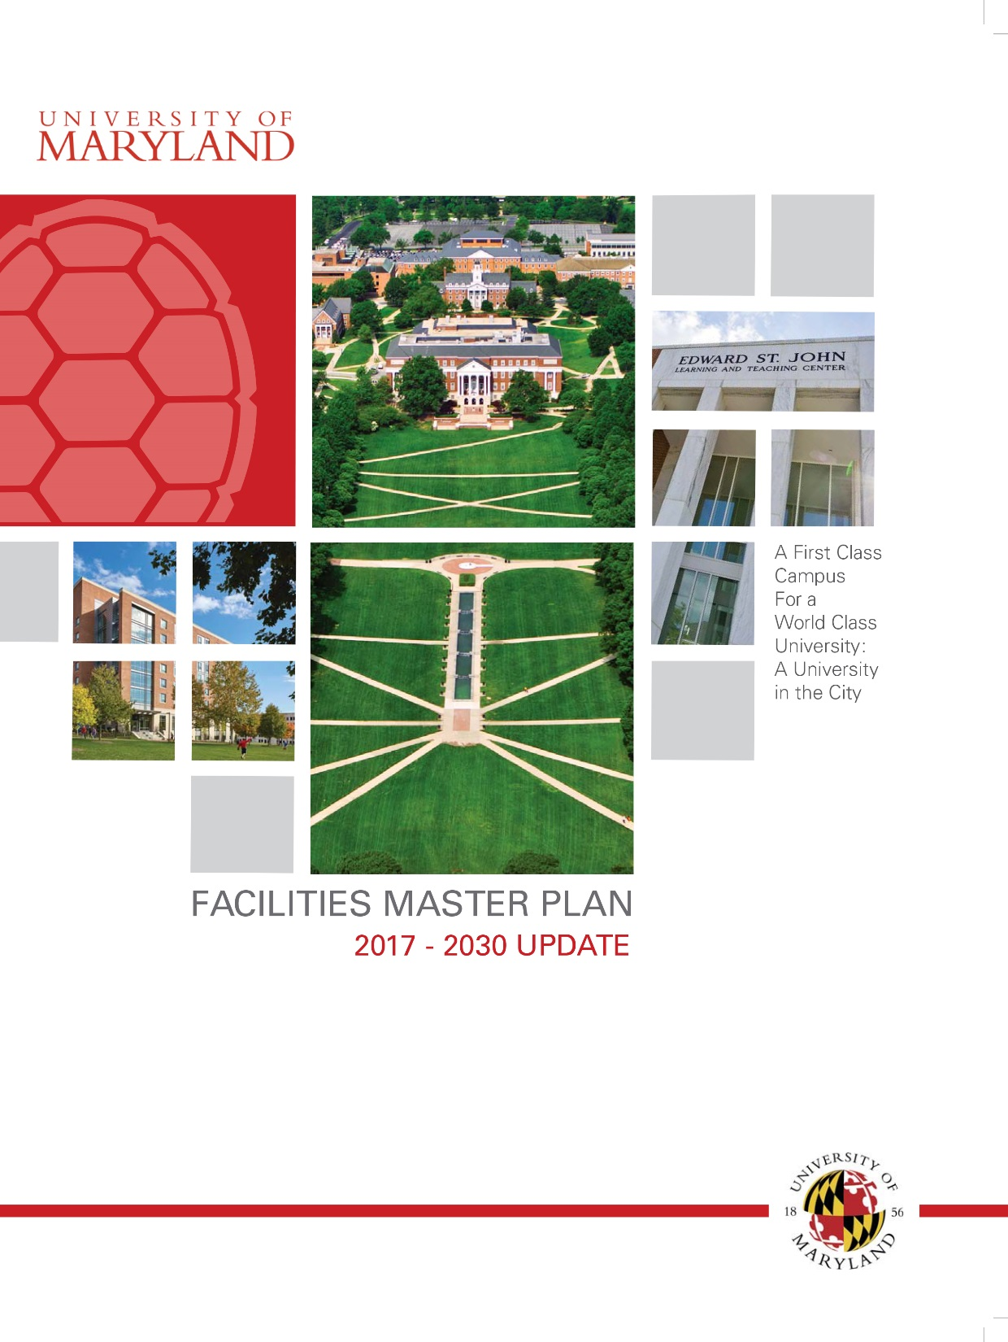
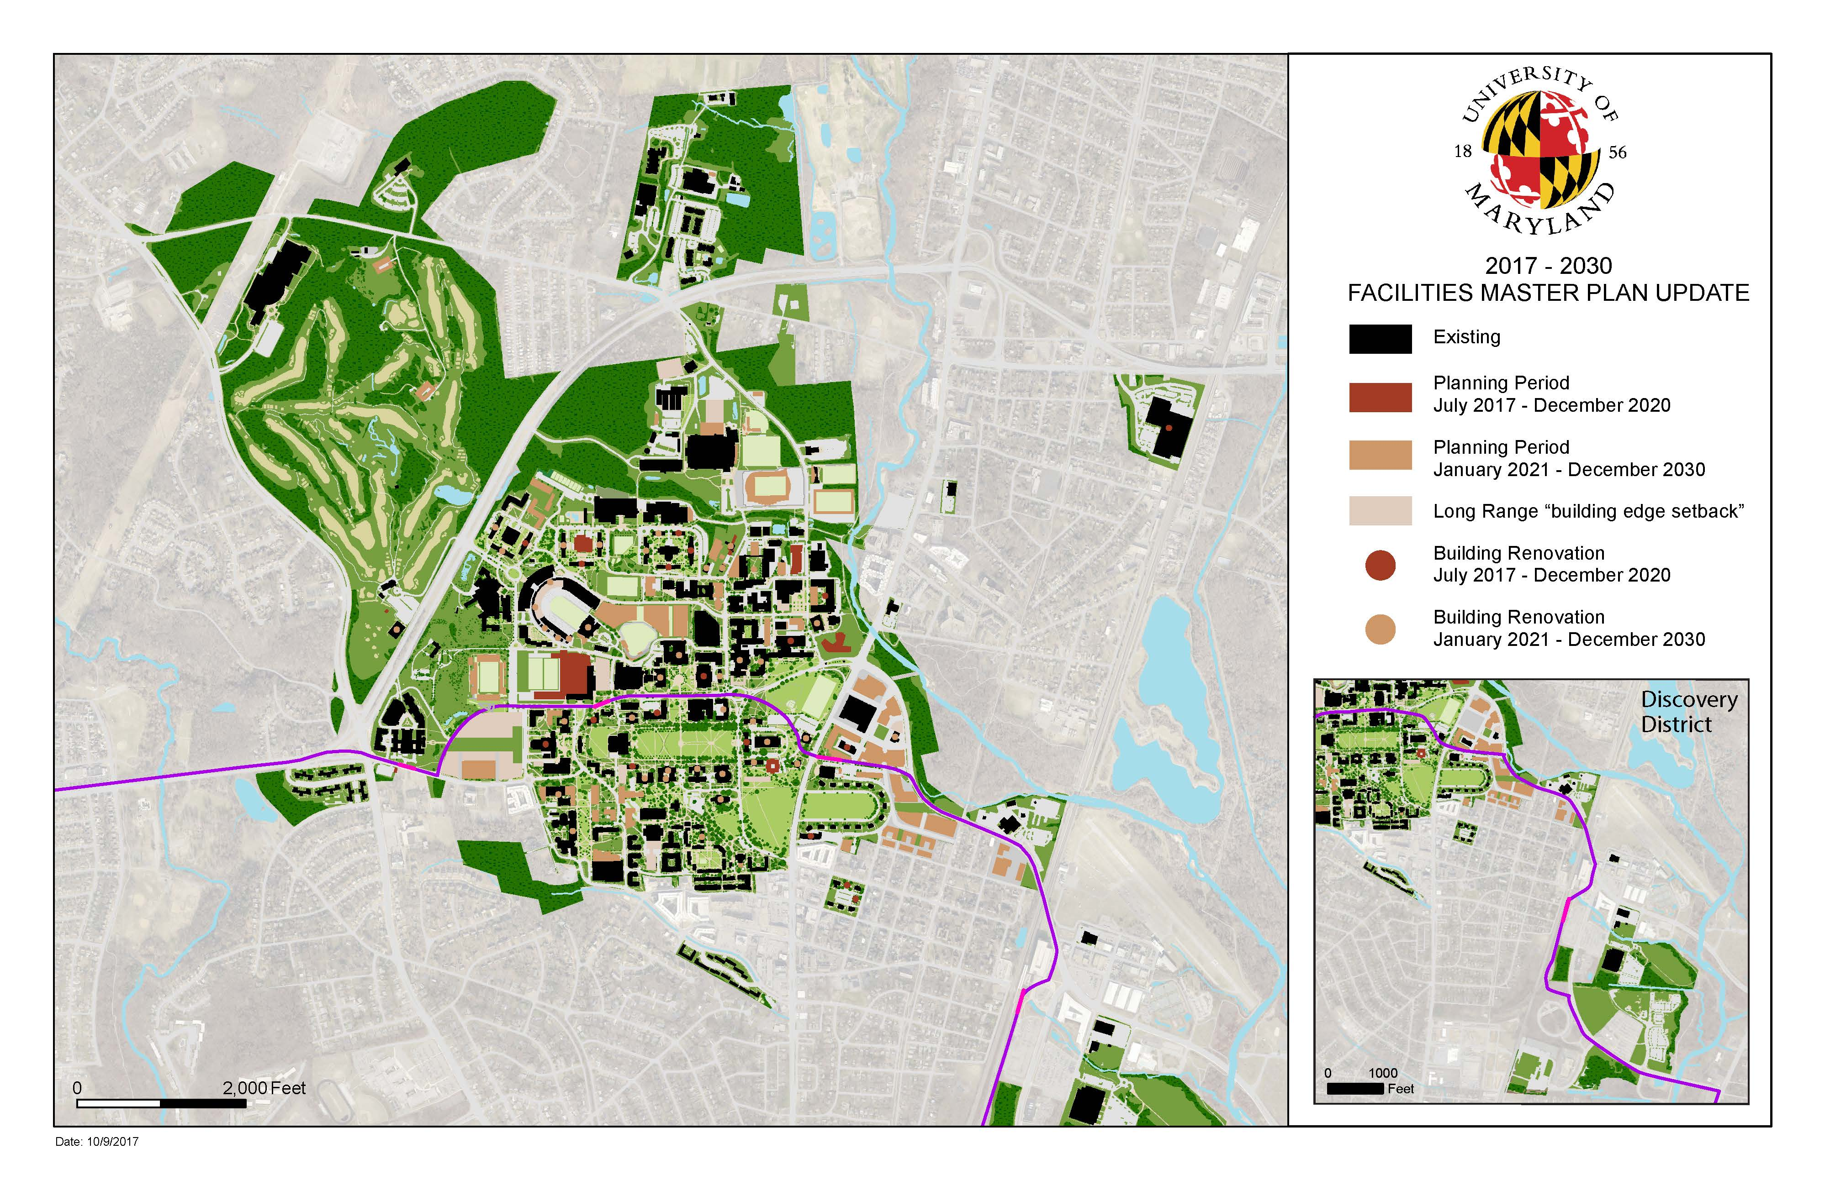
UNIVERSITY OF MARYLAND
BOARD OF REGENTS FINANCE COMMITTEE
November 16, 2017
1

Slide 2
Facilities Master Plan
2017 – 2030 Update
 | Fall 2010 | Fall 2016
Total Acreage | 1,346 | 1,340
Total Buildings | 460 | 442
GSF Facilities | 14,650,154 | 15,254,344
NASF Facilities | 8,275,738 | 8,599,994
NASF Surplus/(Deficit) | (1,712,671) | (1,795,231)
2

Slide 3
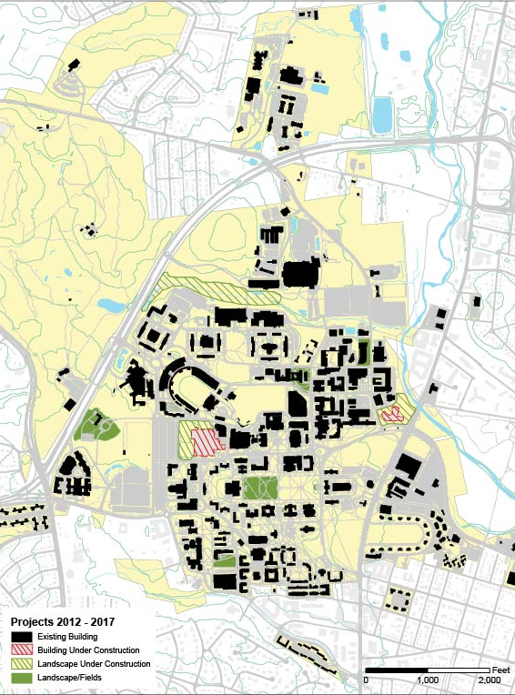
Accomplishments
2012 - 2017
Environmental stewardship initiatives and partnerships:
  Tree Campus USA recognition for 9 consecutive years
  Joint reforestation projects with the Washington Metropolitan Council of Governments- Anacostia Restoration Partnership
  Free-standing bio-retention facilities via grants
  On-going restoration of Campus Creek with MD DNR
Campus Open Spaces (new and enhanced):
  McKeldin Mall – master plan, phase I & phase II restoration and enhancements
  Garden of Reflection and Remembrance
  Washington Quad Renovation
  Environmental site design (ESD) for all new building projects

Slide 4
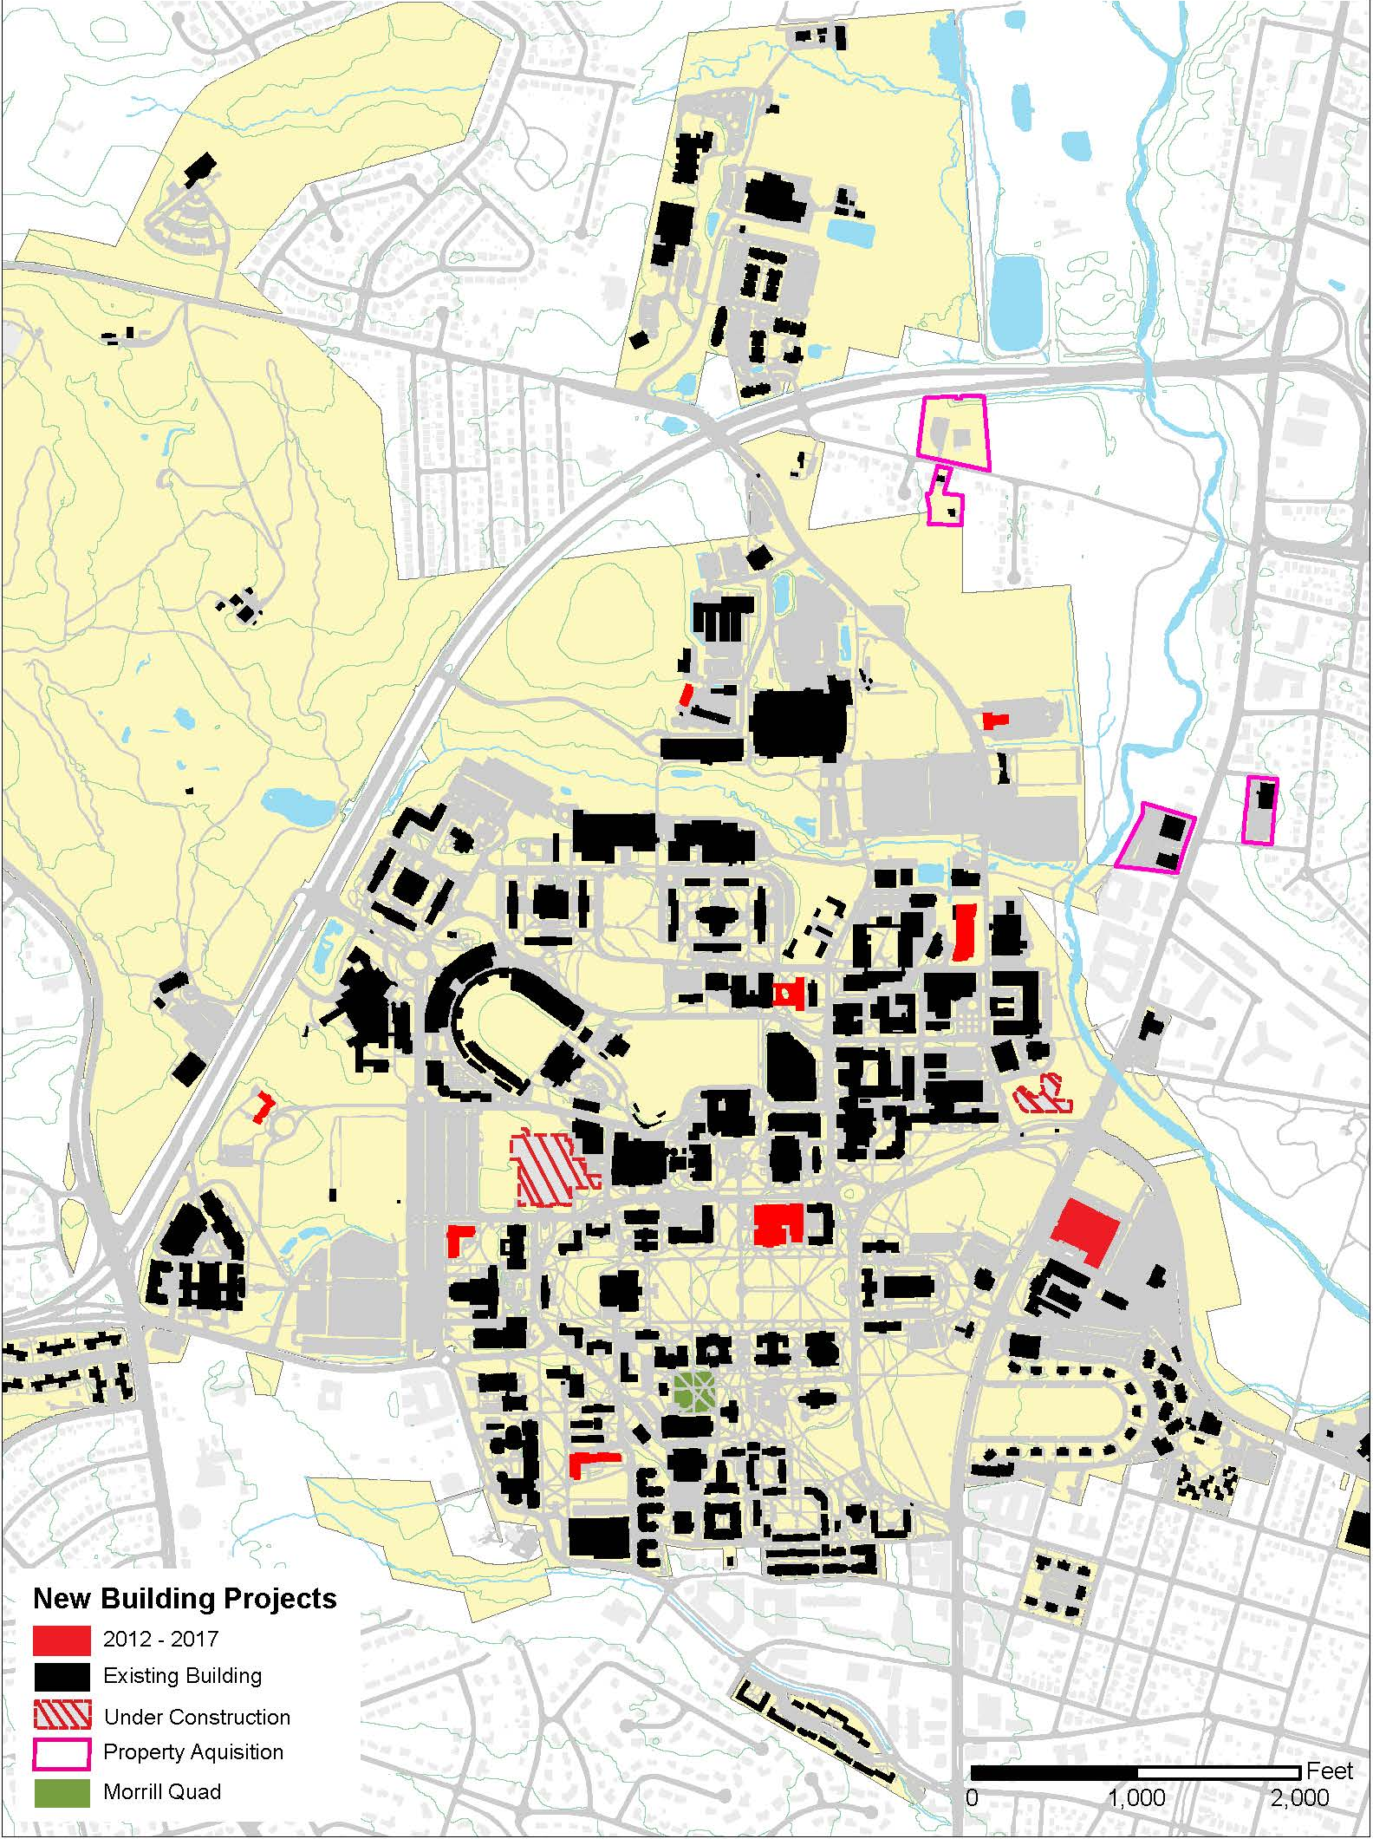
Accomplishments
2012 – 2017
Buildings and Infrastructure:
Completed 55 projects: new construction, renovation, renovation, transportation and demolition of obsolescent buildings
Major new campus facilities:
Physical Sciences Complex | $139M
Prince Frederick Hall | $78M
Edward St. John Learning & Teaching Center | $115M
A. James Clark Hall | $168M
Brendan Iribe Center for Computer Science & Innovation* | $152M
The New Cole Fieldhouse* | $195M
 | $847M
*Under construction

Slide 5
Accomplishments
2012 - 2017
 | Projects Completed 2011-2017 | GSF Completed 2011-2017
New Construction | 11 | 1,796,199
Renovations | 19 | 870,251
Landscape/ Transportation Improvements | 5 | NA
Demolitions | 20 | 126,357
Total | 55 | 2,792,807
Completed 55 of 97 (57%) projects planned in the 2011-2017 period.

Slide 6
2011 - 2030 Plan Updates
 | Projects Planned | GSF Planned
New Construction | 64 | 9,774,163
Renovations | 74 | 3,869,597
Landscape/ Transportation Improvements | 69 | NA
Demolitions | 73 | 902,782
Total | 280 | 14,546,542
Updated 2017

Slide 7
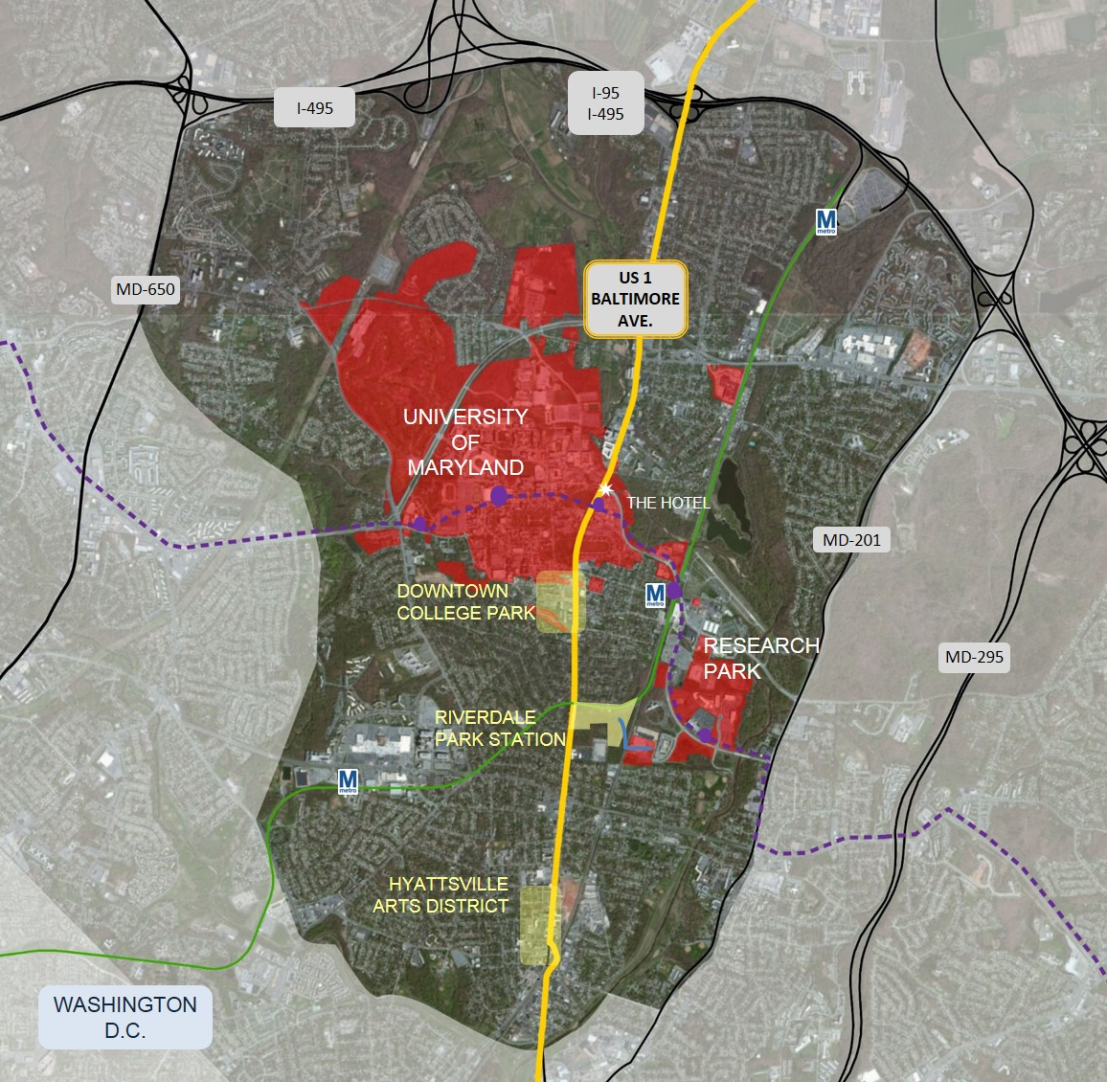

Updated Program Initiatives
Greater College Park
  $1,000,000,000 in private and public investment to create an innovation and entrepreneurial ecosystem.
Discovery District
  Rebranding of the University’s property east of Baltimore Avenue to better connect our main campus to the research park and areas available for redevelopment.
  The hub of UMD innovation and entrepreneurial activities.
7

Slide 8
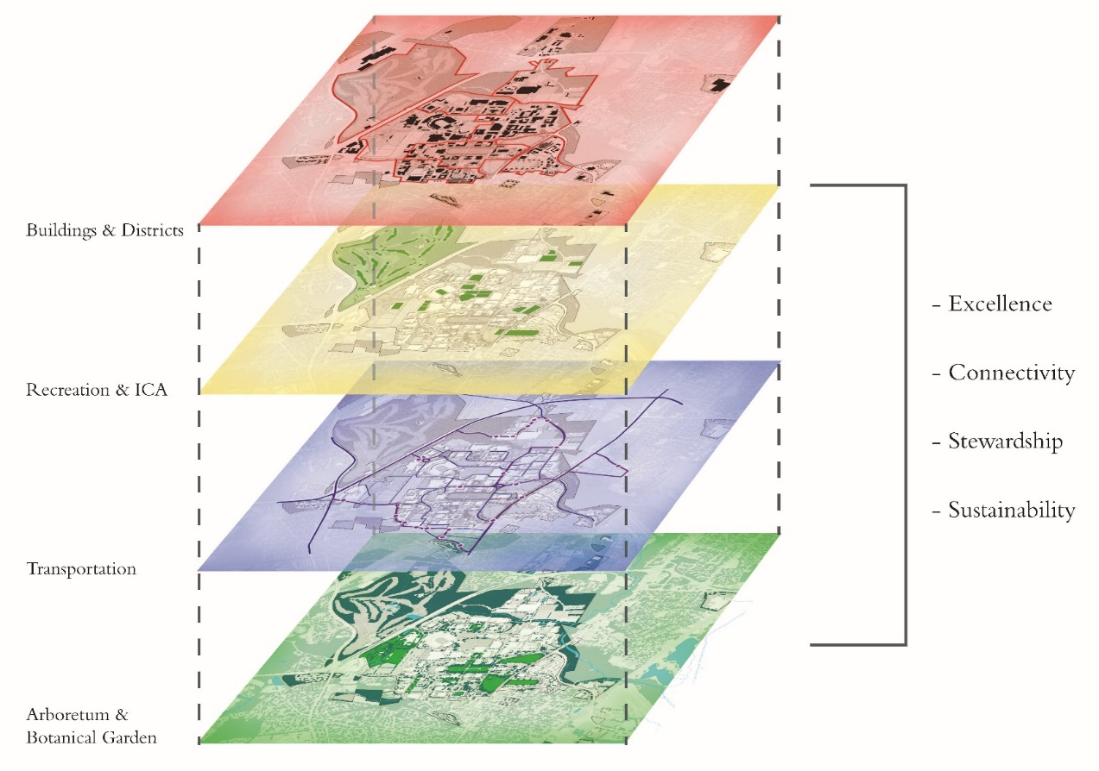
Future Framework
2017 – 2030
Land use planning for a holistic community:

Slide 9
UNIVERSITY OF MARYLAND
BOARD OF REGENTS FINANCE COMMITTEE
November 16, 2017
9

