Slide 1

Tweaking the pilot
A Case Study from DVMT 100 at Frostburg State University
Dr. Megan E. Bradley

Slide 2
DVMT 100 @ FSU
Intermediate algebra, developmental math course
3 credits, does not count toward graduation or GPA*
Must take if need MATH 102 (College Algebra) or MATH 106 (Algebra with Calculus – Business majors)
About 450 students per year
  1078% increase since inception in 1985

Slide 3

Course Issues
Failure rate with gender gap:
  41% failure rate overall
  44% rate for males; 35% rate for females
Staffing
  Relied solely on undergraduate students to teach the course, supervised by staff member

Slide 4
What we did
Emporium Model
Hired new staff to serve as lead instructor
  Undergraduates became ULAs, shifting role to lab assistant

Slide 5
Pilot – spring ‘11
Traditional lecture
  all face-to-face (f2f) classes
  no online work
  taught by trained undergraduates
  point system for course grade
  1 final exam but could have earned other points with previous assignments to make final exam not have much weight
Redesign
  Lecture 1x/week by instructor & lab 4x/week with trained Undergraduate Learning Assistants (ULAs) using ASAlgebra by Plato
  3 modules & corresponding exams
    Mastery learning – retake exams until passed
  Pass course by passing all 3 modules with 80% or higher
    Extra credit for attending and doing online homework & evaluates

Slide 6
assessment
Pass/Fail rates
Scores on “core questions”
  Questions that show up on the redesign module exams & the final exams for the traditional sections
Focus groups

Slide 7

Pilot results
Pass/fail
  Historical failure rate: : 41%
  Redesign failure rate: 47.2% which was significantly worse than…
  Traditional failure rate: 22.6%
  Males failed more than females

Slide 8
Pilot results
Core questions
  Difficult to use final grades due to different grading systems
  Considering all core questions, a one-way ANOVA of Type of Classroom (2: Redesign versus traditional) by Core Qs (All) was significant, F = 37.429, p = .000, eta2 = .327.
  Redesign students (X = 87.98%) performed significantly better than traditional students (X = 63.14%).

Slide 9

Pilot results
Core questions
  Below is a breakdown of core questions per module,
  Students from the redesign section scored significantly higher than traditional sections for all three modules:
  M1: Redesign (X = 86.20%) > traditional (X=83.66%)
  M2: Redesign (X = 84.90%) > traditional (X=74.07%)
  M3: Redesign (X = 90.85%) > traditional (X=59.05%)

Slide 10
Pilot results
Regression indicated which of course activities significantly related to student grade on core questions.
  Attendance: correlated but weak
  Online homework: correlated but weak
  Online evaluates: strongly correlated
    Homework & evaluates: needed 80% to pass and move on
      Evaluates: Often only had 4 questions so needed to get perfect score.

Slide 11

Additional results
We examined students’ time on task and when they were using software.
Reviewed focus group suggestions.
Compared student performance on certain items in traditional sections.
Created hypotheses and tested them out as best as we could.
Reassessed the team

Slide 12
Issues & tweaks
Students compared DVMT 100 sections.
Redesign students did not effectively use their lab time wisely.
Redesign students did not have enough deadlines – 1x/module, night before exam.
Students fell behind next module while retaking previous module exam.
Fall 2011 – full implementation.
Changed lab to 2x/wk and used technology to block other sites.
Created several deadlines with last deadline before test review day.
Added retake week after Mod1.

Slide 13
Issues & tweaks
The grading system in the redesign confused students.
Redesign students found and exploited a loophole about retaking modules next semester.
Lab assistants were scattered across different labs.
No pedagogy to address gender gap.
Revised to be based on weights that required and rewarded important course aspects.
Modified retaking of modules.
Assigned lab assistants.
Created Train Your Brain Program

Slide 14
Issues & tweaks
Failure rate on first version of module exam was very poor:
  Mod1 = 27% passed
  Mod2 = 20% passed
  Mod3 = 17% passed
Implemented PreModule Exam
  Earn 85% or higher – no need to take Module exam
    Reward studying & doing well

Slide 15

Full implementation results
Remember this?
  Failure rate with gender gap:
    41% failure rate overall
    44% rate for males; 35% rate for females
    Pilot redesign failure rate: 47.2%
Fall 2011 pass/fail rate
  20.3% failure rate overall
  19.7% rate for males; 21.3% rate for females
  Gender analyses NOT statistically significant.

Slide 16
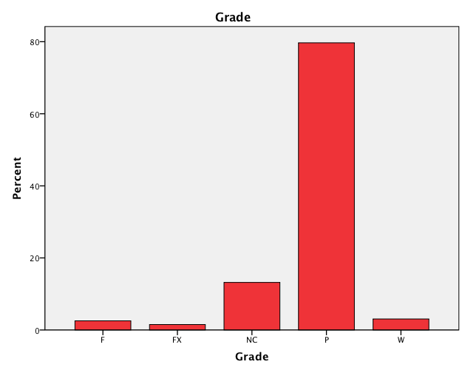
What a pretty graph!

Slide 17
Impact of changes
Deadlines = large % students completed deadlines
Weights & lab changes = better attendance and time on task
Train Your Brain = no gender gap, better performance overall

Slide 18

Impact of changes
Failure rate on first version of module exam was very poor:
  Mod1 = 27% passed
  Mod2 = 20% passed
  Mod3 = 17% passed
PreModule Exam results
  Module 1
    Premod: 36% passed
    Version 1: 72% passed
  Module 2
    Premod: 16.2% passed
    Version 1: 60% passed
  Module 3
    Premod: 18.3% passed
    Version 1: 53% passed

Slide 19
Overall recommendations
Look, look, look.
Add structure.
Improve based on evidence (from pilot, from other redesigns, from published research)
Add psychology
  Provide incentives
  Spacing effect
  Practice effect
  Mastery learning

Slide 20


Your reward

