Slide 1
Simplifying the Complex:
Creating Transparent Evaluation in Multi-institutional Education Partnerships
American Evaluation Association Annual Conference
San Antonio, TX
November 10-13, 2010
Presenters: Dewayne Morgan- University System of Maryland; Susan Tucker- Evaluation & Development Associates; Danielle Susskind- University System of Maryland
http://www.usmd.edu/usm/academicaffairs/p20/

Slide 2
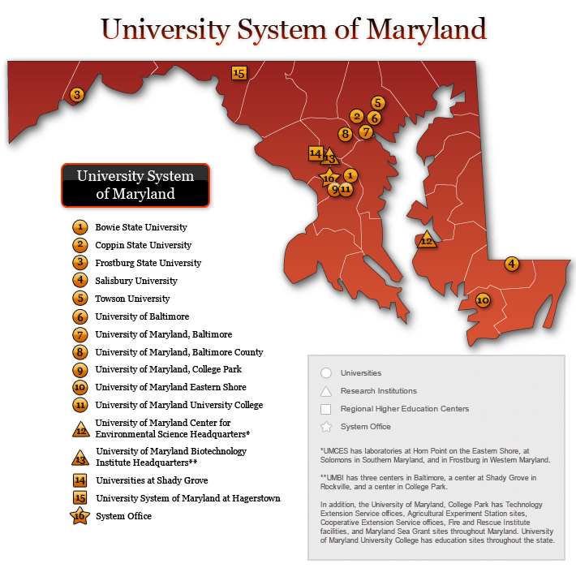


Slide 3
University System of Maryland
P-20 Partnership Projects
Project Learning in Communities (LINC) (USDE TQE)
Education Equals Mentoring, Coaching and Cohorts (E=mc²) (USDE TQE)
Vertically-Integrated Partnerships K-16 (VIP K-16)(National Science Foundation)
Minority Student Pipeline Math Science Partnership (MSP)² (National Science Foundation)

Slide 4
Transparent Evaluation
A process of evaluation where all stakeholders can see:
what is being evaluated
how it is being evaluated and
why it is being evaluated

Slide 5
Creating Transparency in Evaluation
Language and Communication:
  Evaluators need to communicate what we already know, how we know it, and what we want to know
Evaluators also need to understand:
  who needs to know what?
  when do they need to know it?
Not everything can be simplified- it is about becoming comfortable with complexity

Slide 6
Partnerships
A collaborative relationship between parties (e.g., IHE,K-12 schools and districts, community members/organizations, and/or the business community) that is both mutually dependent on and beneficial to one another.
                (Miller & Hafner, 2008)

Slide 7
Partnership Contexts
Project | External Evaluator (EE) | Internal Evaluator (IE) | Project Specific Contexts
TQE 1 | On the ground Consistent Utilization & Improvement Oriented Responsive to Grant Development | No IE originally, though program manager ensured daily data collection | In place before 524b All partners stable throughout grant Qualitative evidence of partnership
TQE 2 | Shifting models of evaluation Three different EEs Recognized need for more local EE given highly dynamic IHE contexts prior relationships with LEAs | No formal IE position but need was recognized Part time doctoral student position appointed in Year 2 IE role grew over time | K-12 partner superintendent turnover frequent Goals more stable, but partners reps shifted School system in high flux

Slide 8
Project | External Evaluator (EE) | Internal Evaluator (IE) | Project Specific Contexts
MSP 1 | EE evaluated on macro level Proof vs improve model Task Oriented | No formal IE | Partnership” not defined consistently High Achieving LEA involved all G9-12 science teachers High content-faculty engagement
MSP2 | consultant coach role Facilitates weekly conf calls with IE focuses on macro level analysis Helps frame questions for strands Clear role definition between EE and researchers | Formal IE designated full time IE sends reports to EE On the ground Daily data collection Facilitating data collection for individual researchers School system data analyst devoted to project | Same TQE1 partners EE co-designing macro efforts with research Push back from partners about collaboration Common data base development Agents of school district no LEA R&D Funder expectations clearer than MSP1

Slide 9
Lessons learned across projects…
IE position must be formalized
Active vs. passive definitions of partnership can affect capacity, development & sustainability
Research issues linked to tenure
Create sanctioned time for research
Understand differences across IHE partners
Have a Memorandum of Understanding

Slide 10
Implementation Challenges:
Series of Iterative Polemics
Polemic: Project Goals/ Objectives | Challenges/Issues | Evaluation Strategies | Relevant Literature/Practices
•Hierarchically/ unilaterally v. collaboratively determined Value base of goals Multiple definitions of partnership | Establishing goals that are not overly ambitious Defining goals relevance to actual project activities | Evaluator should be involved in the proposal process Partner workplans | Patton (1990; 2010) Fetterman (2007; 2010) Miller & Hafner (2008)

Slide 11
Polemics of Iterative Implementation
Polemic Core Concepts | Challenges/ Issues | Evaluation Strategies | Relevant Literature/ Practices
Clear/ negotiated vs. unclear/ untested | Core terms not defined & accepted No creation of a “shared vocabulary” EX: PLC, PD… | Steering committees and cross-institutional multi-institutional strands | Fetterman (2007; 2010) Kundin (2010)

Slide 12
Polemics of Iterative Implementation
Polemic Program Proofs vs. Improvement | Challenges/Issues | Evaluation Strategies | Relevant Literature/ Practices
Minimals-Value Added Data Access Sustainability Issues Internal & External Eval Evaluation co-designed, developed, and budgeted by partnerships Leveraging across divergent funding Evaluator continuity Capacity evaluation Long term goals & logic maps | Understanding how timing contexts affect benchmarks Formative/Summative Shift from discrete activities to cohesive partnerships | Periodic evaluation discussions Using different measurements of evaluation based-on time constraints Minimals extended by value added | Desimone (2009)

Slide 13
Polemics of Iterative Implementation
Polemic: Partnership | Challenges/Issues | Evaluation Strategies | Relevant Literature
Benefits vs. liabilities Junctions vs. disjunctions Motivation vs. disincentives Expertise vs. collaborative models Stability vs. instability Incremental vs. transformative Tie to policies & context constraints | Complex collaborative relationships between partners & organizations Values of academia do not reward faculty for partnering Flawed processes are commonly employed Issues framed differently by diverse partners who get things done? who does what (both the institutional and individual “who”) | Understanding institutional histories Clear external expectations & obligations of partners Ensuring adequate resources devoted to partnership Ensuring unique aspects of each “community” considered in all collaborative efforts | Miller & Hefner (2008) Holland & Gelman (1998) Johnson & Oliver (1991) Ascher & Schwartz (1989) Gronski & Pigg (2000) Bryk & Rollow (1996) Gray (2000) Johnson & Oliver ( 1991)

Slide 14
Implementation Challenges:
A Series of Iterative Polemics continued…
Polemic: Evaluation | Challenges/Issues | Evaluation Strategies | Relevant Literature/ Practices
Active vs. passive capacity building External v. internal Quantitative vs. qualitative vs. mixed Data sharing across partners Process vs. product balance Conflict vs. “fit” with researcher(s) | Understanding existing sources of data (partners often do not know what date they have or could get) Partner “buy-in” to evaluation as helpful & adaptable to their work and institutional landscape | Evaluator(s) relationships with decision makers Evaluators seen as a resource as opposed to an outside entity Staff positions dedicated to evaluation | Patton (1990; 2010) Scriven (2010) Wayne, Yoon, Zhu, Cronen & Garet (2008) Kundin (2010)

Slide 15
Implementation Challenges:
A Series of Iterative Polemics continued…
Polemic: Project Achievement / Success | Challenges/Issues | Evaluation Strategies | Relevant Literature/ Practices
Tangible vs. intangible indicators Partner ownership | Interpreting and using formative evaluations Developmental evaluation appropriate in many reform, P-20 partnerships | Communication vehicles with stakeholders sometimes look different depending on partners Steering committee Non-partnership committee meetings | Astbury & Leeuw (2010) Patton (1990; 2010) Kundin (2010)

Slide 16
Bibliography
Ascher,C.,& Schwartz,W. (1989). School-college alliances: Benefits for low-income minorities(ERIC Digest No. 53). New York:ERIC Clearinghouse on Urban Education.
Astbury, B. & Leeuw, F.L. (2010). Unpacking black boxes: Mechanisms and theory building in evaluation. American Journal of Evaluation, 31 (3), 363-381.
Bryk, A. S., &Rollow, S. G. (1996). Urban school development: Literacy as a lever for change. Educational Policy, 10(2), 172-202.
Desimone, L. M. (2009). Improving impact studies of teachers’ professional development: Toward better conceptualizations and measures. Educational Researcher, 38, 181.
Donaldson, S.I., Patton, M.Q., Fetterman, D. M., & Scriven, M. (2010). The 2009 Claremont debates: The promise and pitfalls of utilization focused and empowerment evaluation. Journal of MultiDisciplinary Evaluation, 6 (13), 15-57.
Fetterman, D. & Wandersman, A. (2007). Empowerment evaluation: Yesterday, today and tomorrow. American Journal of Evaluation, 28, 179.
Gray, B. (2000). A critique of assessing collaborative efforts: Assessing inter-organizational collaboration. Cooperative Strategy, pp. 243-261.
Gronski, R., & Pigg, K. (2000). University and community collaboration. American Behavioral Scientist, 43(5), 781-792.
Johnson, J. H., & Oliver, M. L. (1991). Urban poverty and social welfare policy in the United States: An undergraduate research/training program. Journal of Geography in Higher Education, 15(1), 25-35.
Kundin, D. M. (2010). A conceptual framework for how evaluators make everyday practice decisions. American Journal of Evaluation, 31 (3), 347-362.
Miller, P.M., & Hafner, M.M. (2008). Moving toward dialogical collaboration: A critical examination of a university -school-community partnership. Educational Administration Quarterly, 44 (1), 66-110.
Patton, M. Q. (1990). Qualitative evaluation and research methods(2nd ed.). Newbury Park, CA:Sage.
Wayne, A. J., Yoon, K.S., Zhu, P., Cronen, S., & Garet, M.S. (2008). Experimenting with teacher professional development: Motives and methods. Educational Researcher, 37, 469.

Slide 17
Contact Information
Dewayne Morgan
University System of Maryland
dmorgan@usmd.edu
Susan Tucker
Evaluation & Development Associates LLC
sutucker1@mac.com
Danielle Susskind
University System of Maryland
dsusskind@usmd.edu

